Slide 1

File and Printer sharing in Windows NT Environment
NATIONAL INSTITUTE OF ELECTRONICS AND INFORMATION TECHNOLOGY
Birla Farms, Bada Phull, Ropar
NIELIT ‘O’-Level
IT Tools and Network basics

Slide 2
Index
Introduction to Spreadsheet
Spreadsheets, sheets and cells
Spreadsheet Layout
Creating, opening, saving and printing a spreadsheet
Navigation within sheets
Selecting cells, rows/columns and sheets
Working with columns, rows and sheets
Inserting and Deleting rows and columns
Resizing rows and columns
Working with sheets
Inserting and deleting sheets
Move and Copy sheets
Renaming sheets
Formatting data and cells
Formatting Data – Number, text, date
Formatting cells – Font, Alignment, Text wrapping, Merging ad splitting, Background and Border
Conditional Formatting – Color Scale, Data Bars, Icon Set, Condition

Slide 3
Index
Sorting and Filtering
Freezing and splitting panes

Slide 4
Introduction to Spreadsheets

Slide 5
Introduction to Spreadsheets
A spreadsheet is a computer application for analysis, organization and storage of data in tabular form. Furthermore in a spreadsheet we can manipulate the data to produce certain results. . Calc is the spreadsheet component of LibreOffice. Other features provided by Calc include:
Functions, which can be used to create formulas to perform complex calculations on data.
Database functions to arrange, store, and filter data.
Dynamic charts giving a wide range of 2D and 3D charts.
Ability to open, edit, and save Microsoft Excel spreadsheets.

Slide 6
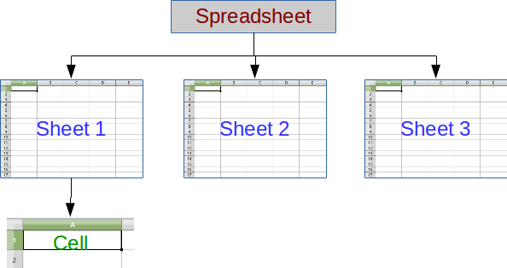
Spreadsheets, sheets, and cells
In Calc you create files that are called spreadsheets.
A spreadsheet consist of a number of individual sheets, each sheet containing cells arranged in rows and columns.
A particular cell is identified by its row number and column letter (for example cell B8).
Each spreadsheet can have many sheets, and each sheet has a large number of individual cells.
Each cell can contain data in the form of text, numbers or formulas.
In Calc, each sheet can have a maximum of 1,048,576 rows and a maximum of 1024 columns.

Slide 7
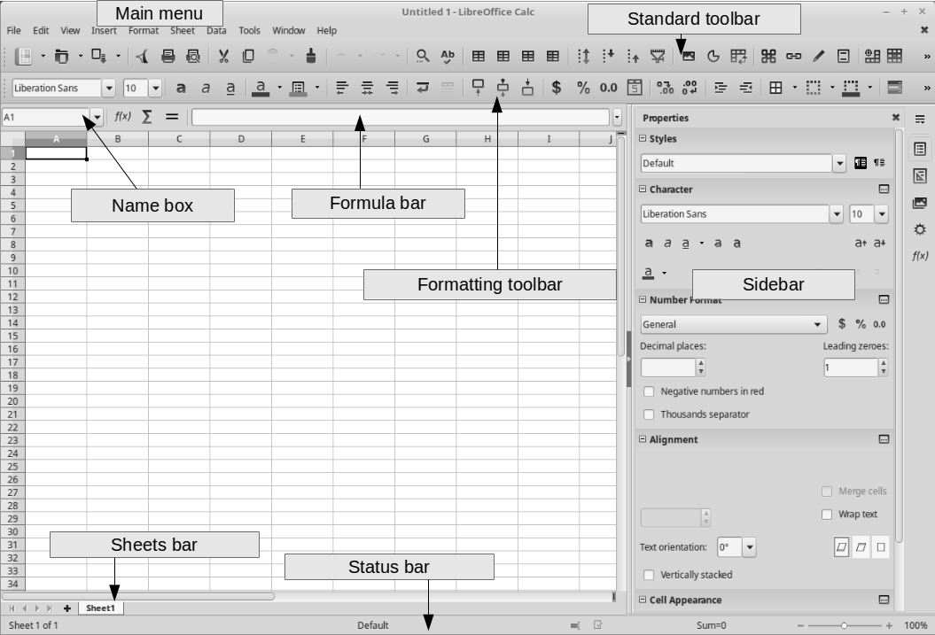
Spreadsheet Layout
When Calc is started, the main window opens and the various parts are shown in the image below. The Menu bar, toolbars, Sidebar and Status bar have similar functionality with other LibreOffice components.

Slide 8
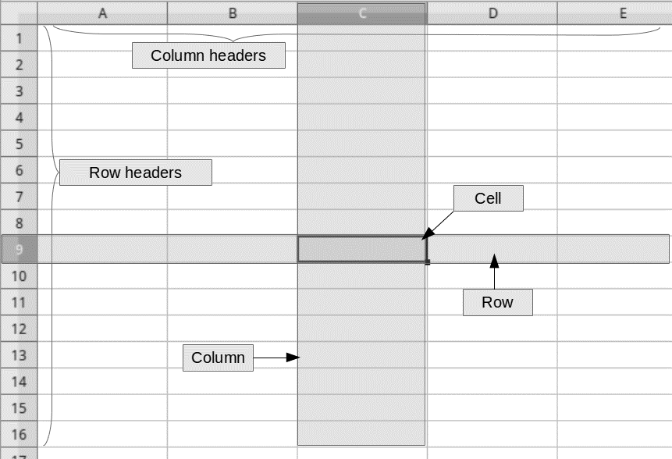
Spreadsheet layout
The main section of the workspace in Calc displays the cells in the form of a grid.
Each cell is defined by the intersection of one column and one row in the spreadsheet.
At the top of the columns and the left end of the rows are a series of header boxes containing letters and numbers.
The column headers use an alphabet character starting at A and go on to the right.
The row headers use a numerical character starting at 1 and go down.

Slide 9
Name box and Formula bar
The name of the active cell is displayed in the Name box.
The name of each cell is formed by the letter of the column and its line number.
The active cell is the one we have selected each time using the mouse or keyboard.
Next to the Name Box is the Formula Bar that displays the formula or just the contents of a cell.
In the Formula bar there are buttons for inserting functions into a cell.
Formulas and functions allow us to enter calculations into a cell based on the values ​​of other cells.

Slide 10
Sheets bar
In Calc one can have more than one sheet in a spreadsheet.
At the bottom of the grid of cells in a spreadsheet the sheets bar is located, indicating how many sheets there are in your spreadsheet.
Clicking on a sheet's tab enables access and displays to the workspace each individual sheet. An active sheet is indicated with a highlight color in the sheet's tab.

Slide 11
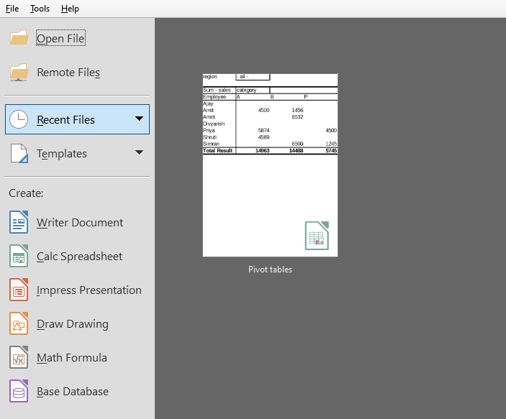
Creating a new document
Choose Create -> Calc Spreadsheet from left pane to create a new file
One can also choose to work with a starting template.

Slide 12
Saving and Exporting spreadsheets
Calc uses the Open Document Format with the extension *.ods to save spreadsheets. If one needs to exchange files with users who are using Microsoft Ofiice, Calc supports saving to xls format. Of course you can export a spreadsheet to a variety of file formats including CSV, PDF, HTML and other formats.
Choose File -> Save from the menu bar
Also you can use keyboard shortcut Ctrl+S to save a document
Or Click the Save icon on the Standard toolbar.
Choose File->Save as ,if you want to save the current version as a new document by changing the file name or file type, or by saving the file in a different location on your computer.

Slide 13
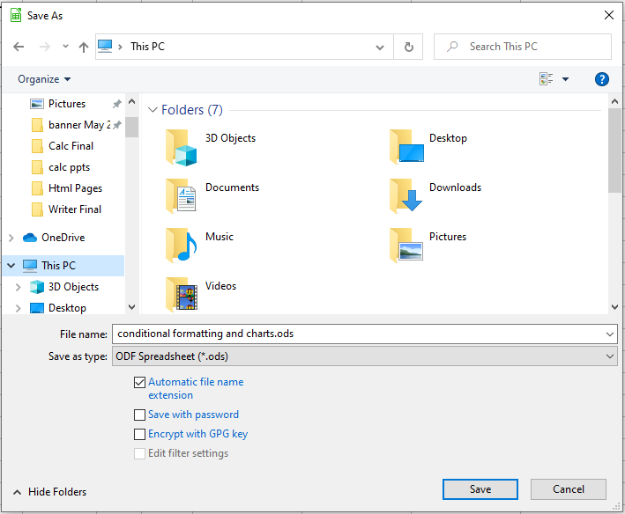
Saving and Exporting spreadsheets

Slide 14
Opening an existing spreadsheet
Click Open file option from the left pane to open an already existing file
Also one can use the keyboard shortcut Ctrl+O to open a document.

Slide 15
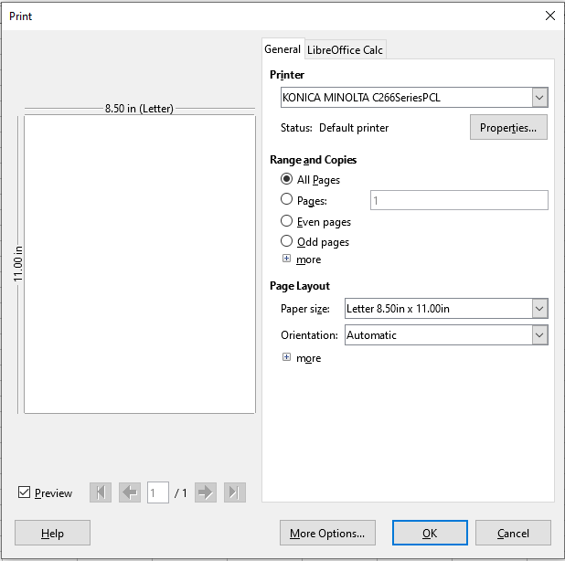
Printing a sheet
To quickly print a spreadsheet, click on the Print icon on the Standard toolbar
For more control over printing, select File > Print on the Menu bar or press Ctrl+P
The Print dialog has multiple tabs where you can choose a range of options.

Slide 16
Printing a sheet
Printer
Select the printer to use, from the list of those available.
Click the Properties button to change any required settings of the selected printer.
Range and Copies
Select which sheets and pages to print
Single or double sided printing
The number of copies to print
Page Layout
Select page layout properties such as paper size, portrait, or landscape orientation
How many pages are printed per sheet of paper
The order in which the pages are printed on a sheet of paper and whether a border is drawn around each page.

Slide 17
Navigating and Selecting within spreadsheets

Slide 18
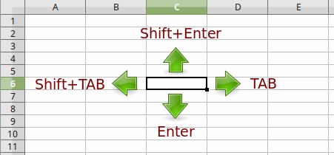
Navigating and Selecting within spreadsheets
Working with spreadsheets usually involves editing a large number of cells. Therefore it is an essential skill to navigate quickly and make selections inside a spreadsheet.
Cell navigation
You can navigate to any cell by clicking with the mouse, however you should learn the following navigation shortcuts keys to speed up data entry with Calc.

Slide 19
Navigating and Selecting within spreadsheets
Enter key moves the cell focus down the next row.
Shift+Enter moves the focus up to the previous row.
Tab moves the cell focus right the next column.
Shift+Tab moves the focus left the next column.
Alternatively you can navigate using the arrow keys on the keyboard or the Page Up, Page Down, Home and End keys.

Slide 20
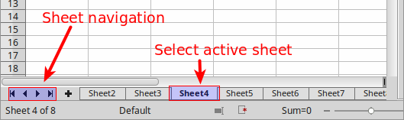
Sheet navigation
Each sheet inside a spreadsheet file is independent of the other sheets, though you can refer to a cell from another sheet when using formulas. To navigate between different sheets in a spreadsheet:
Click on one of the sheet tabs at the bottom of the spreadsheet or
Use the Navigator tab in the Sidebar.
If there are a lot of sheets in your spreadsheet, then some of the sheet tabs may be hidden behind the horizontal scroll bar at the bottom of the screen. In this case, use the four buttons to the left of the sheet tabs to move the tabs into view.

Slide 21
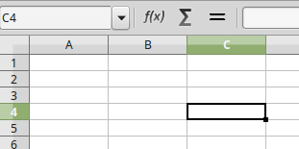
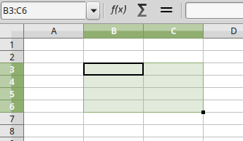
Selecting cells
Single cell
To select a cell using the mouse, place the mouse pointer over the cell and click the left mouse button. When a cell is selected or in focus, the cell borders are emphasized. The cell reference name is displayed in the Name Box in the Formula bar.
Range of contiguous cells
A range of cells can be selected using the keyboard or the mouse. The cells range name is displayed in the Name Box in the Formula bar. A cell range has the following syntax. In the example below the selected cell range is named B3:C6

Slide 22
Selecting cells
1) To select a range of cells using the mouse:
Select the upper left cell.
Press and hold down the left mouse button.
Move the mouse cursor to the lower right cell and release the left mouse button.
2) To select a range of cells using the SHIFT key:
Select the upper left cell
Hold down the SHIFT key.
Select the lower right cell.
3) You can also directly select a range of cells using the Name Box. Click into the Name Box on the Formula Bar and type the cells range name.

Slide 23
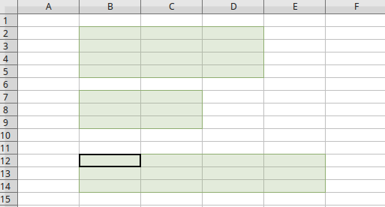
Selecting cells
Range of non-contiguous cells
Select the cell or range of cells using one of the methods above.
Hold down the CTRL key
Using the mouse move and select the next cell or range of cells.
Repeat the above step for all required selections.

Slide 24
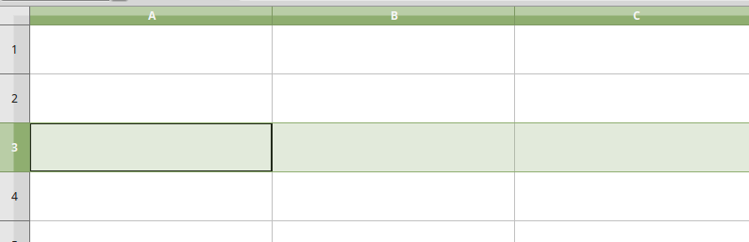
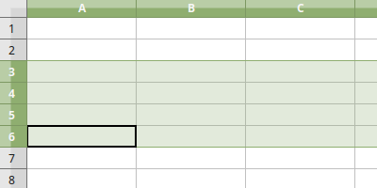
Selecting columns and rows
Single column or row
To select a single column or row, click on the column or row header.
Multiple columns or rows
To select multiple columns or rows that are contiguous:
Click on the first column or row in the group.
Hold down the SHIFT key.
Click the last column or row in the group.

Slide 25
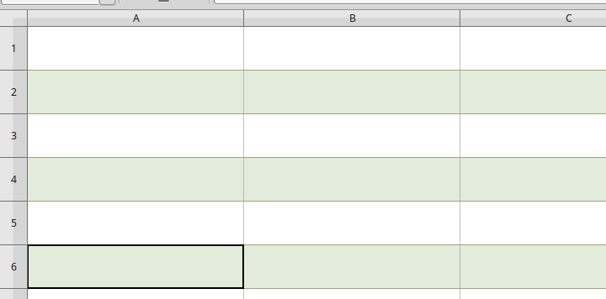
Selecting columns and rows
To select multiple columns or rows that are not contiguous:
Click on the first column or row in the group.
Hold down the CTRL key.
Click on all of the subsequent columns or rows while holding down the CTRL key.

Slide 26
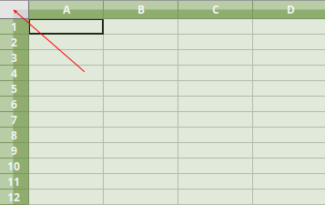
Selecting sheets
Entire sheet
To select the entire sheet, click on the small box between the column headers and the row headers, or use the key combination CTRL+A to select the entire sheet.
Selecting sheets
One can select either one or multiple sheets in Calc. It can be advantageous to select multiple sheets, especially when one wants to make changes to many sheets at once.

Slide 27
Selecting sheets
Single sheet
Click on the sheet tab for the sheet one wants to select. The tab for the selected sheet becomes white.
Multiple continuous sheets
To select multiple contiguous sheets:
Click on the sheet tab for the first desired sheet.
Move the mouse pointer over the sheet tab for the last desired sheet.
Hold down the Shift key and click on the sheet tab.
Multiple non-contiguous sheets
To select multiple non-contiguous sheets hold down the CTRL Key while selecting each sheet.
All sheets
Right-click a sheet tab and choose Select All Sheets from the context menu.

Slide 28
Working with columns, rows and sheets

Slide 29
Introduction
Α sheet can be seen as a large table, therefore it is essential to learn how to add, remove and resize rows and columns. When working with multiple sheets inside a spreadsheet some basic sheet editing commands are also required.

Slide 30

Inserting and deleting rows and columns
To insert or delete rows and columns use the Standard toolbar buttons or the context menu items. To insert or delete a row or column:
Click on any cell of the row or column
Use one of the following buttons
Click the button to insert a row above the current row.
Click the button to insert a column left to the current column.
Click the button to delete the current row.
Click the button to delete the current column.
Alternatively one can use the context menu to access the above commands. Right click on a column or row header and choose one of the available commands.

Slide 31


Resizing rows and columns
Note that when inserting columns or rows one does’ntt actually add new ones, only the contents are added and the data to adjacent cells are moved. The same applies when you delete columns or rows.
Resizing
One can resize the width of a column or the height of a row with one of the following ways:
a) Dragging
Place the mouse cursor on the edge of a column or row header and when the resize mouse icon appears drag to resize.
b) Using the context menu
In this way one can resize multiple columns or rows at once. Select one or more columns or rows and right click to bring the context menu. Select the Column Width (or Row Height) command to bring the window to set the new size.

Slide 32
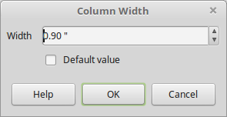
Resizing rows and columns
Type the value for the column width (or row height).
Optimal column width or row height.
To quickly change the width of a column or height of a row place the mouse cursor on the edge of a column or row header and double click. The width or height will adjust to the optimal size.

Slide 33
Working with Sheets

Slide 34

Working with sheets
Inserting new sheets
Click on the Add Sheet icon. This creates and inserts a new sheet after the last sheet in the spreadsheet.
Or you can use the context menu. Right click on the Sheets Tab and choose the Insert Sheet command.

Slide 35
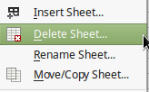
Working with sheets
Delete sheets
Right-click on the sheet tab where one wants to delete a sheet and select Delete Sheet from the context menu.

Slide 36
Working with sheets
Moving and copying sheets
You can move or copy sheets within the same spreadsheet by dragging and dropping or using the Move/Copy Sheet dialog. To move or copy a sheet into another spreadsheet file you must use the Move/Copy Sheet dialog. To bring the Move/Copy Sheet dialog right click on a sheet and select the Move/Copy Sheet command from the context menu. In this dialog you can set the following:
Choose the action type (move or copy)
The document location (current spreadsheet or another)
The sheet's new location
The new name when copying a sheet

Slide 37
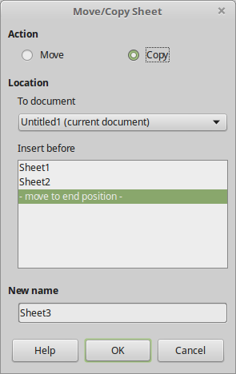
Working with sheets

Slide 38
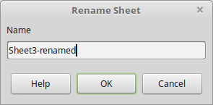
Working with sheets
Renaming sheets
By default, the name for each new sheet added has the format SheetX, where X is the number of the next sheet to be added. While this works for a small spreadsheet with only a few sheets, it can become difficult to identify sheets when a spreadsheet contains many sheets. One can rename a sheet using one of the following methods:
Right-click on a sheet tab and select Rename Sheet from the context menu to replace the existing name with a different one.
Double-click on a sheet tab to open the Rename Sheet dialog.

Slide 39
Formatting Data and Cells

Slide 40
Formatting Data
Cells inside a spreadsheet can contain text or numerical data. Data in Calc can be formatted into various forms in order to denote the type of data and thus make cells more readable without changing the actual data values.
Text
The most basic data a cell can contain is simply text. To enter text inside a cell, simply select the cell and type the text using the keyboard. Text is left-aligned by default and can exceed the cell boundaries. This can be confusing to inexperienced users who mistakenly think the text is located to the adjacent cell. To check the actual contents of a cell select the cell and look at the input line in the Formula bar on the top of the window. A solution to this problem is to increase column width, force a new line or wrap text around the cell.

Slide 41
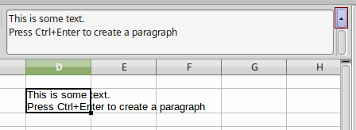
Formatting Data
To force a new line of text (or a paragraph) use the CTRL + ENTER key combination. When a cell contains multiple lines of text you might find it more practical to use the input line text box of the Formula Bar. Click on the Extend Formula Bar icon located on the right of the Formula Bar and the text box becomes multi-line, as shown in the image above.

Slide 42
Formatting Data
Numerical data
Spreadsheets are used mainly to process, analyze and extract information from numerical data and create this way applications to help us with everyday personal, business and scientific tasks. Calc can format numerical data and change their appearance according the quantity they represent. The most basic data formats Calc supports are:
Integer numbers
Numbers with decimal places (real numbers)
Currency
Percent
Date and Time

Slide 43
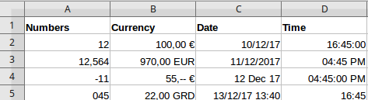
Formatting Data
For example one can control the number of decimal digits, the date and time format or display a currency symbol next to a value. In this way it helps the user to better understand the information displayed in a spreadsheet while at the same time keeping the numerical value intact. Furthermore one can quickly change the formatting of any cell with just one command. The following table shows some examples of numerical data formatting.

Slide 44
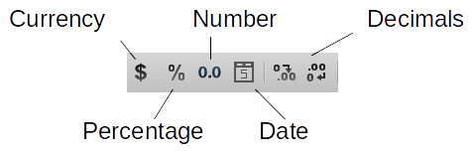
Formatting Data
Formatting using the toolbar
To quickly format a value entered in a cell to currency, percent, number, date or add decimal places use the corresponding buttons in the Formatting toolbar.

Slide 45
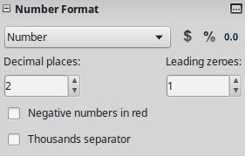
Formatting Data
Formatting with the Properties tab
For more data formatting options one can use the Number Format section in the Properties tab in the Sidebar.

Slide 46
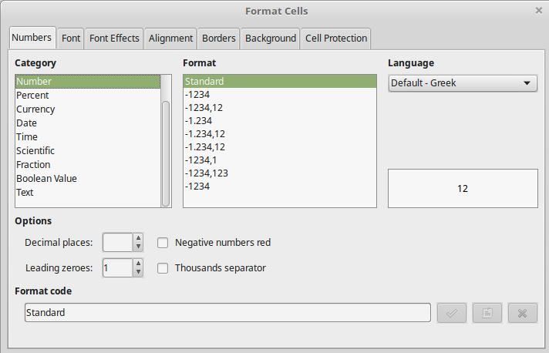
Formatting Data
The Format Cells window
In this window one has all the formatting options available.
To open this window click the icon in the sidebar or use the context menu item Format cells.
Choose the Category and the Format type. A preview of how data is displayed is shown on the right of the Cell formatting window. If one must use a formatting from a different locale change the Language in the drop down menu.

Slide 47
Formatting Data
Date and Time
It is important to understand that Date and Time in Calc are stored and treated internally as numbers. However you can format the display of a date and time to one of the available formats. To enter a date you must separate the date elements with a slash (/) or a hyphen (–). The date format automatically changes to the selected format used by Calc. When you enter a time, separate time elements with colons, for example 10:43:45. The time format automatically changes to the selected format used by Calc. In both cases Calc recognizes the data you entered as date or time and not as simple text or numbers.
The following are valid date or time formats:
20/10/2012
20-10-2012
20 Oct 2012
10:43:45
10:43 AM

Slide 48
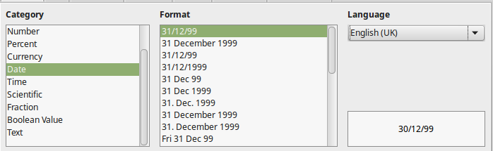
Formatting Data
Once date or time has been entered, one can change the default format to one of the available formatting options for date and time. Use the Format Cell window to list and preview the available formats.

Slide 49
Formatting Cells
Cells in a spreadsheet have similar properties with table cells in Writer. One can format the appearance of cells like for example changing fonts, alignment, borders and background colors. To format a cell or a group of cells one can use one of the following tools:
Formatting toolbar
Sidebar
Format Cell window

Slide 50
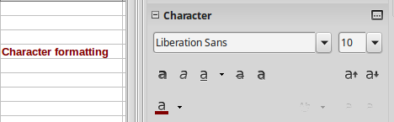
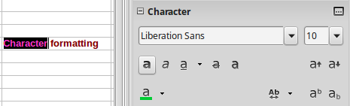
Formatting Cells
Formatting characters
When one clicks on a cell or a group of cells one can apply character formatting using the toolbar or the Sidebar. This formatting applies to all contents of the cell or cells.
To format part of a text in a cell double click inside the cell, select the text and the apply the formatting.

Slide 51
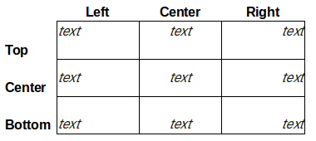
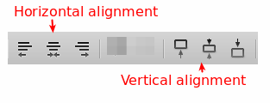
Formatting Cells
Cell Alignment
One can align the contents of a cell both vertically and horizontally. The results of each alignment type are shown in the table below.
To align cells use the alignments buttons on the Formatting toolbar.

Slide 52
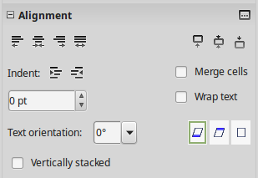
Formatting Cells
Or one can use the Alignment Section on the Sidebar.

Slide 53
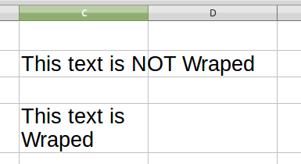
Formatting Cells
Text wrapping
Text entered into a cell does not wrap around cell borders. To change this behavior one must enable Text Wrapping on a cell or group of cells. To enable Text Wrapping use the wrap text button from the Formatting toolbar or the Sidebar.

Slide 54
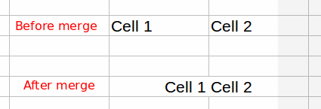
Formatting Cells
Merging and Splitting cells
One can merge two or more cells and combine them to one. To merge select the cells and click on the merge cells button. Calc will ask if one wants to move the contents of the second cell to the first. To split the cells back select the cells and click again on the merge button.

Slide 55
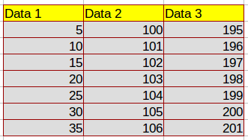
Formatting Cells
Cell Borders and background
Using borders and background color one can format the cells in a spreadsheet in order to change the visual display of the data. An example of border formatting and background color is shown in the figure below.

Slide 56
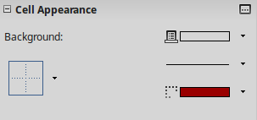
Formatting Cells
Background color
To apply background color to a cell or a group of cells, select and then click on the background color button on the Formatting toolbar.
When one clicks on the arrow in this button one can select another color. Using the same button one can change the color or remove the background color (No Fill option).

Slide 57
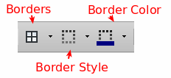
Formatting Cells
Borders
To quickly set and style the borders around cells use the buttons from the Formatting toolbar. One can set the border type, line style and color.
Alternatively one can use the Cell Appearance section in the Sidebar

Slide 58
Conditional Formatting

Slide 59
Introduction
One can set up cell formats to change depending on conditions that one specifies. Conditional formatting is used to highlight data that is outside the specifications that you have set.
Conditional formatting provides another way to visualize data inside a spreadsheet. Using this tool one can automatically apply formatting such as colors, icons, and data bars, to a range of cells based on a condition or cell value.
It is recommended not to overuse conditional formatting as this could have the opposite results and make your spreadsheet look confusing.
Calc provides the following conditional formatting types:
Condition
Color Scale
Data Bar
Icon Set

Slide 60
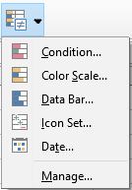
Setting up conditional formatting
To set up conditional formatting use one of the conditional formatting buttons in the Formatting Toolbar.
In general to setup conditional formatting
Select the range of cells that one wants to format
Click one of the formatting types
On the Conditional Formatting window set one or more conditions

Slide 61
Applying Color Scale
Use Color scale to set the background color of cells depending on the value of the data in a spreadsheet cell. Color scale can only be used when All Cells has been selected for the condition. You can use either two or three colors for your color scale. Click on the Color Scale button to open the Conditional Formatting window. The value and the type of the scale (percentile, percentage, maximum, minimum) determines the coloring of the cells.

Slide 62
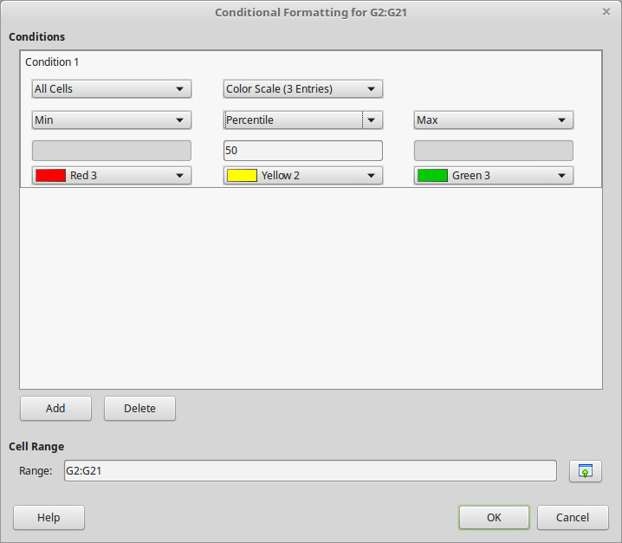
Applying Color Scale

Slide 63
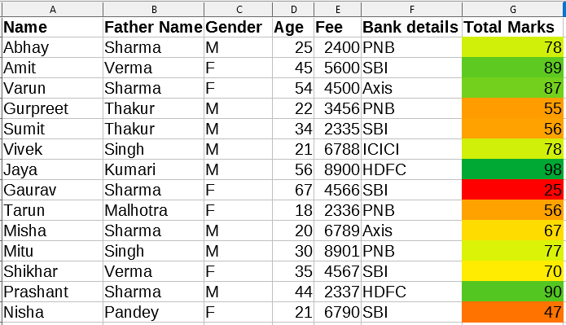
Applying Color Scale
The results of color scale formatting are shown below. In our example, the closer the cell values approach to 50% of the age distribution become yellow. The upper and lower bounds of the distribution become green and red respectively.

Slide 64
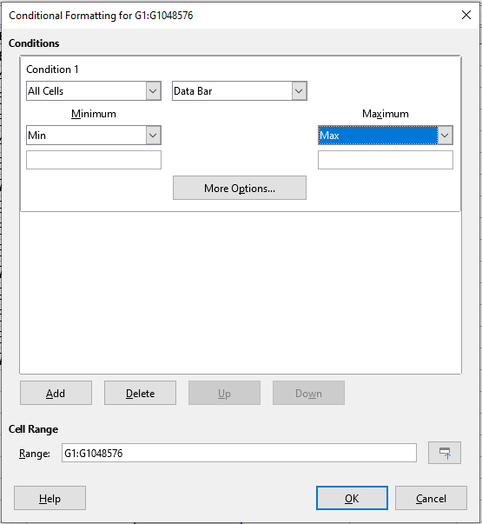
Applying Data bars
Data bars provide a graphical representation of data in the spreadsheet. The graphical representation is based on the values of data in a selected range. Data bars can only be used when All Cells has been selected for the condition. Use the Data Bar button to open the Conditional Formatting window.

Slide 65
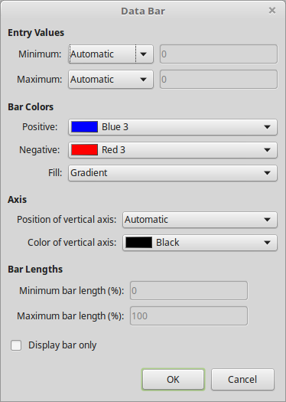
Applying Data bars
Click on More Options in the Conditional Formatting dialog to define how the data bars will look.

Slide 66
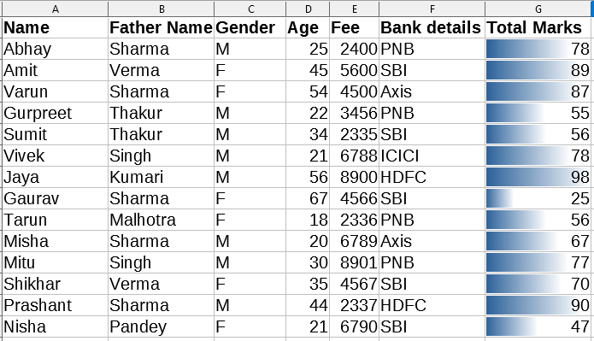
Applying Data bars
The data bar formatting results are shown below. For each cell there is a small bar chart with a width depending on its value.

Slide 67
Applying Icon Set
Applying Icon Set
Icon sets display an icon next to the data in each selected cell to give a visual representation of where the cell data falls within the defined range that you set.
The icons sets available are colored arrows, gray arrows, colored flags, colored signs, symbols, bar ratings and quarters.
Icon sets can only be accessed when the Conditional Formatting dialog has been opened and All Cells has been selected for the condition.
Use the Icon Set button to open the Conditional Formatting window. In our example, we fill in the two values that will define the three data ranges and their respective icons.

Slide 68
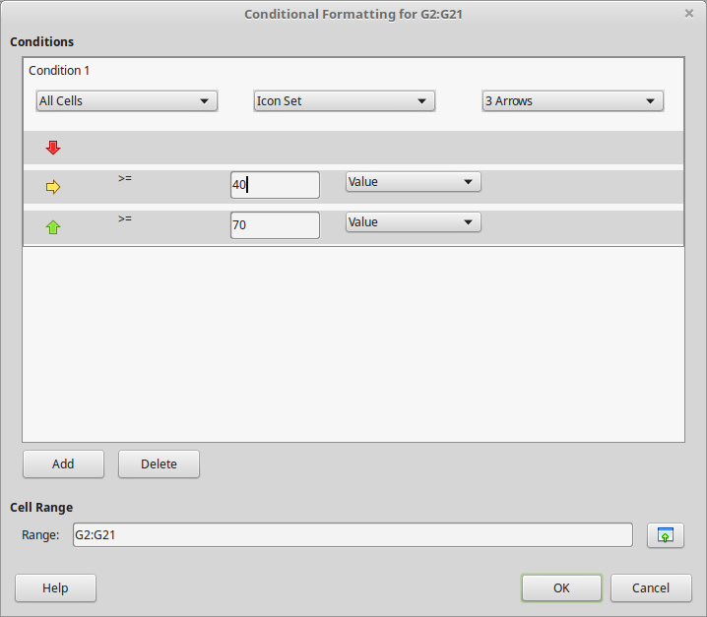
Applying Icon Set

Slide 69
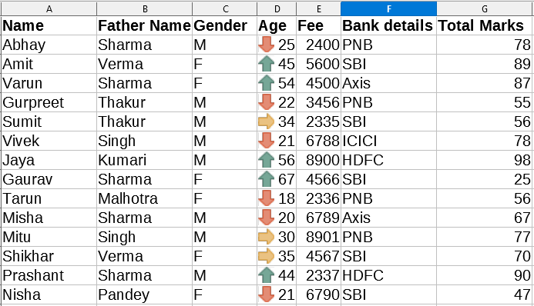
Applying Icon Set
The results of Icon Set formatting are shown below.

Slide 70
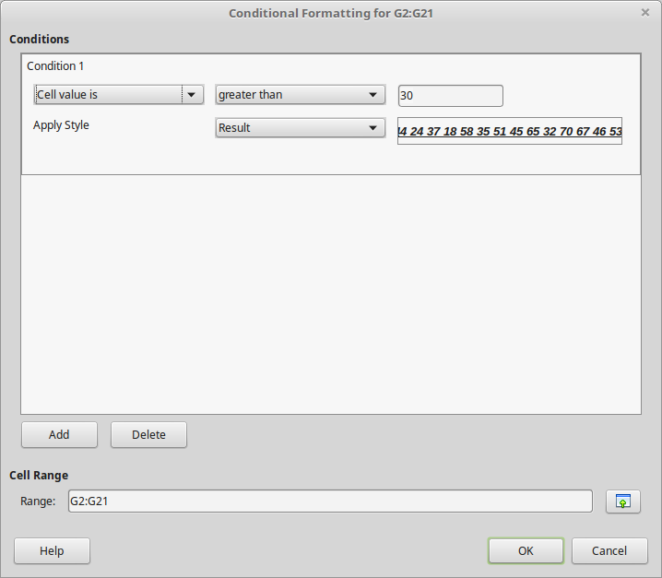
Applying Condition
With Condition one can apply a certain style to the data according to a condition one sets. One can use the spreadsheet's predefined styles or create one’s own formatting style before using this method. Use the Condition button to open the Conditional Formatting window. In the following example a rule is set to apply the Result style to all cells with a value greater than 30.

Slide 71
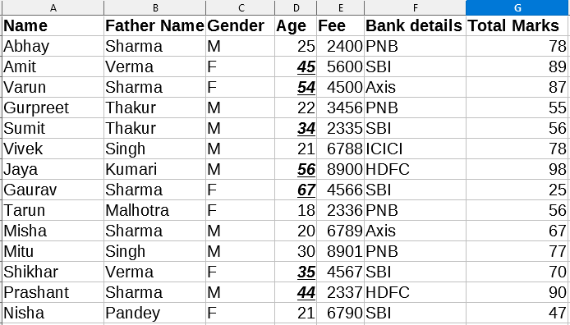
Applying Condition
The results of Condition are shown below.

Slide 72
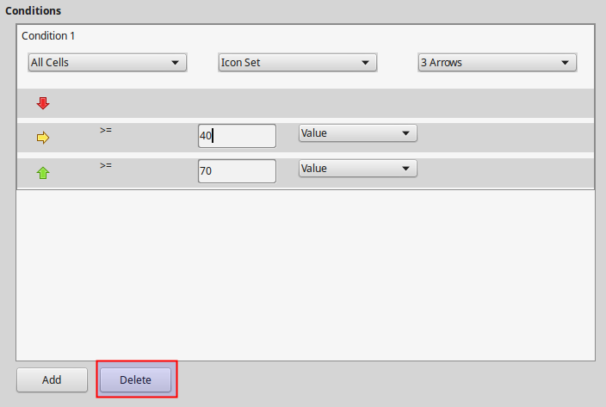
Edit and Remove conditional formatting
To Edit a conditional formatting previously applied, select the cells, click on the used conditional formatting button and edit the condition parameters. One can also add condition using the Add Button. To remove a condition click the Delete button.

Slide 73
Sorting and Filtering

Slide 74

Introduction
When working with data in a spreadsheet there is need to arrange and organize the data for better viewing and finding. Furthermore Calc is used as a simple database tool and ask simple questions in order to extract useful information from the data. This is done using the Sorting and Filtering tools. Sorting and filtering in Calc can be accessed using the Sort and Filter section in Standard Toolbar.
Sort ascending
filter
Sort
Sort descending

Slide 75
Sorting
Sorting is the process of rearranging data in a range or a sheet according to a specified sort order. Several criteria can be used and a sort applies each criteria consecutively.
Sorting is useful when one adds new information to a spreadsheet.
After one has added information, one can then sort the records to update the spreadsheet.

Slide 76
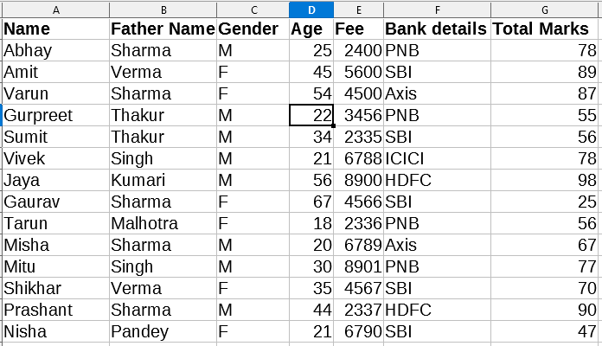
Sorting
Quick sort ascending
To quickly sort a column in ascending order,
1. Select any cell inside the column.

Slide 77
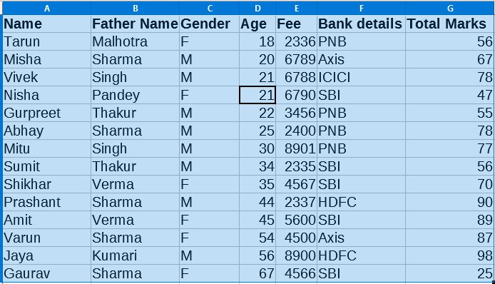
Sorting
2. Click the Sort Ascending button.

Slide 78
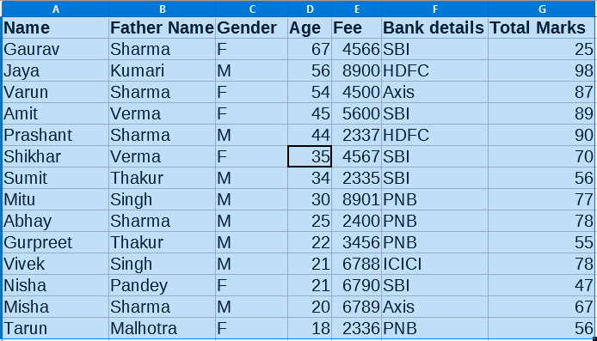
Sorting
Quick sort descending
Repeat the previous steps using the Sort Descending button.

Slide 79
Sorting
How quick sort works
In Quick Sorting Calc automatically
discovers the data to be sorted
recognizes the first row as a header row and does not include this row in the sorting
extends the sorting to the other columns

Slide 80
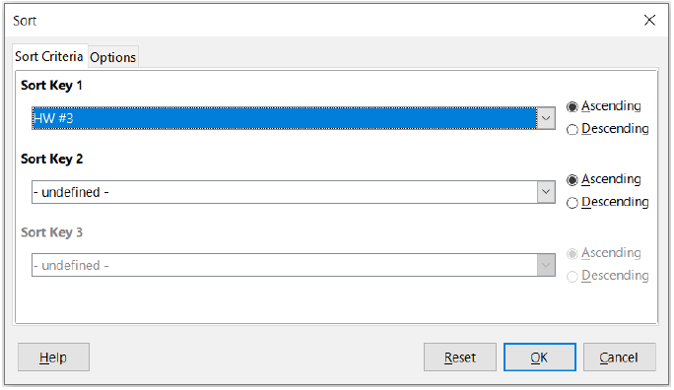
Sorting
The Sort dialog window
For advanced sorting one must use the Sort dialog which can be accessed by selecting Data -> Sort on the Menu bar or by clicking the Sort icon on the Standard toolbar. Using this command one can specify multiple levels of sorting and advanced options.

Slide 81

Sorting
Optionally we can set some more options for the sorting.
Note that by default the Range contains column labels option is enabled. This means that the first row contains headers that we don't want to include in sorting.

Slide 82
Filtering
A filter is a tool that hides or displays records within a sheet based on a set of filtering criteria. Similar to sorting, filters are useful for narrowing down the data in your worksheet, allowing you to view only the information you need. In other words Filters help you to ask questions to your data and retrieve useful information.
Calc provides two types of filter:
Standard – specifies the logical conditions to filter your data.
AutoFilter – Automatically filters the selected cell range and creates one-row list boxes where you can choose the items that you want to display.

Slide 83
AutoFilter
The easiest way to apply filters is using the AutoFilter command. In order to use this command your data must be organized in a table format and meet the following criteria:
the first row contains column headers. The headers describe the column contents (for example name, age, product)
Every row after the first contains only data. Each data row represents a record of your data table.
All records must be in sequence with no empty records in between.

Slide 84

Autofilter
Create an AutoFilter
To create an AutoFilter simply click on the AutoFilter Button. A drop-down arrow will appear in the header cell for each column.
Or click on a cell anywhere within the table area and then select Data > AutoFilter on the Menu bar

Slide 85

Applying a filter
To apply a filter click on a column's drop-down arrow to bring the filter window. In this window you can set the filter criteria. For example to show only the Female persons we deselect the other values.

Slide 86

Applying a filter
After we apply a filter the data in our sheet are updated and the filter drop-down arrow is highlighted to indicate the filter existence.

Slide 87

Applying a filter
We can apply more filters the same way. For example to show only records where Bank is PNB, we add filter to the BANK column. Click the All option to remove all values and the select the Bank ‘PNB’.

Slide 88

Applying a filter
Now apply the second filters on Gender column to display records where gender is F

Slide 89

Standard filter
Standard Filter
For more advanced filters click the Standard Filter option on the Filter drop-down.

Slide 90

Standard filter
The Standard Filter window displays existing filters and allow us to set new custom filters. For example we can set a filter to show only people aged 50 and above.

Slide 91
Standard filter
To create a standard filter in general you specify the
Operator : Can be the logical AND or logical OR.
Field name : This is the name of the column
Condition : A logical condition (equality, greater, less)
Value : The value of the filter.

Slide 92
Removing a filter
Removing a Filter
To remove a Filter click on the drop-down arrow and enable the All option.
Remove AutoFilter
To remove AutoFilters from all columns of a database table, click on a cell anywhere within the table area and select Data > AutoFilter on the Menu bar, select Data > More Filters > Hide AutoFilter on the Menu bar.
Or Click on the Autofilter button to remove the AutoFilter function and all filters from your data.

Slide 93
Freezing and Splitting

Slide 94
Freezing and Splitting
When working with large data it can be difficult to view the information in a spreadsheet. Calc includes two useful tools to help us view the contents of a spreadsheet with large amount of data that exceed the window width or height.
Freeze Rows and Columns
Split Window

Slide 95

Freezing and Splitting
Freeze Rows and Columns
Freezing is used to lock rows across the top of a spreadsheet or to lock columns on the left of a spreadsheet. Then, when moving around within a sheet, the cells in frozen rows and columns always remain in view. The example below shows a spreadsheet with the top row frozen.

Slide 96

Freezing and Splitting
And an example with the first column frozen.

Slide 97

Freezing and Splitting
Freeze a row
To freeze a row select the row below the one you want to freeze and click the Freeze Button. The frozen row will be indicated by a black line on the bottom.

Slide 98

Freezing and Splitting
Freeze a column
To freeze a column select the column on the right and click the Freeze Button. The frozen column will be indicated by a black line on the right.

Slide 99

Freezing and Splitting
Freeze both a row and column
To freeze a row and a column at the same time select the cell that is on the bottom row and on the right column and click the Freeze button.

Slide 100
Freezing and Splitting
Unfreezing
When a row or column in a spreadsheet is frozen the Freeze button is highlighted. To revert a row or column back to normal state and remove freezing simply click on the Freeze button.
Or go to View on the Menu bar and click Freeze Rows and Columns to toggle it off

Slide 101
Freezing and Splitting
Another useful tool to help you view a sheet is the Split Window tool. The screen can be split horizontally, vertically, or both, displaying up to four portions of the spreadsheet at the same time.
Split window horizontally
To split horizontally into two separate windows select a row and click the Split window button.
A gray line indicates the borders between the two windows.

Slide 102

Freezing and Splitting
Split Windows Horizontally

Slide 103

Freezing and Splitting
Split window vertically
To split vertically into two separate windows select a column and click the Split window button.
A gray line indicates the borders between the two windows.

Slide 104

Freezing and Splitting
Split window into 4
To split into 4 separate windows select a cell and click the split window button.
A gray line indicates the borders between the windows.

Slide 105
Freezing and Splitting
Remove the split
When a sheet is split into separate parts the split button is highlighted. To remove the split simply click on the Split Window button.

